Slide 1

KBP Flex- High Molecular Weight Methacrylate (HMWM)
Crack Healer & Sealer
Distributor: WARAJAY INTERNATIONAL (H) PTY LTD
Tel: +61 7 38418833
Fax: +61 7 38414288
Email: info@warajay.com

Slide 2
WHAT IS HIGH MOLECULAR WEIGHT METHACRYLATE (HMWM)?
Metha-crylate monomer development began with the European plastics industry and methyl methacrylate (MMA) followed by high molecular weight methacrylate (HMWM)

Slide 3
Introduction:
The topical application for crack repair uses a thin polymer resin to fill crack. Penetrating by gravity alone, the resin fills the crack and forms a polymer plug the seals out water, salts, and other aggressive elements. In some cases, a structural repair of the crack can be achieved.

Slide 4
Typical causes of concrete cracking:
Steel corrosion
Sulfate attack
Alkali-aggregate reaction (AAR)
Alkali-silica reactivity (ASR)
Other causes:
Over finish
Plastic shrinkage
Flexural crack

Slide 5
What are the benefits of using High Molecular Weight Methacrylate (HMWM).
Simple :
Easy to specify and easy to apply
Uses:
Cracks repair (Healer) and water proofing (Sealer).
Safe:
High flashpoint means low flammability concerns. The Monomer may also be produced pre-promoted to eliminate other safety concern
Effective:
Low viscosity of the High Molecular Weight Methacrylate as well as low surface tension allow the maximum penetration into the cracks.

Slide 6
Continue ..
Versatile:
Successful in a broad range of climates, even in condition down to 4 degree Celsius
Convenient:
With rapid 2 hour cure, even in cold conditions. Traffic can be put back on the road
quickly.
Cost saving:
Less labor intensive as compare to traditional crack injection, easy to install and less inconvenient to the public/traffics

Slide 7
Other benefits:
Polymerizes in concrete to form a tough plastic seal
Penetrates to completely fill micro crack , pores and rebond cracks
Complete seal of bridge deck / pavement from chloride and moisture intrusion
Extend the service life...can be extended as much as 100% if the cracking problem is identified early and addressed quickly.
Better shelve life – 2 years

Slide 8
Physical Properties
100% solid
100% reactive
<25cps viscosity
82 degree Celsius flash point
>3000 psi 24 hour compressive strength
>2000 psi tensile strength
>2500 psi adhesion (ASTM C-882)

Slide 9
How to prepare surface:
Proper preparation of cracks for gravity feed of resin is essential to a successful repair.
All potential barriers to penetration must be removed. Clean away all dirt, grease, paints, curing compounds and sealer. Profile asphalt to exposed concrete.
Cleaning individual cracks: Use wire brushes followed by high pressure. Oil-free compressed air to remove dust from the surface of the crack.
Allow the repair area to dry at least 24 hours before applying the resin. Moisture within cracks and the concrete pores can prevent penetration of the resin materials are not able to easily displace water.

Slide 10
What equipment require?
  Mixing buckets, hand held drills, mixing paddles
  Flat rubber squeegees, brooms or roller
  Small cans or squeeze bottles for pouring into individual cracks
  Grinder and air compressor (min. 135cfm).

Slide 11
What are the safety considerations?
Material Safety Data Sheets (MSDS). Adhere to all manufacturer recommendations for safety equipment and requirements.
Protective clothing. Cover the body fully and use adequate footwear ( gumboots)
Protective eyewear
Rubber gloves
Take precautions with flammable or combustible materials
Ventilate closed spaces. Wear appropriate masks to protect against fumes
Store hazardous materials in a secure area

Slide 12
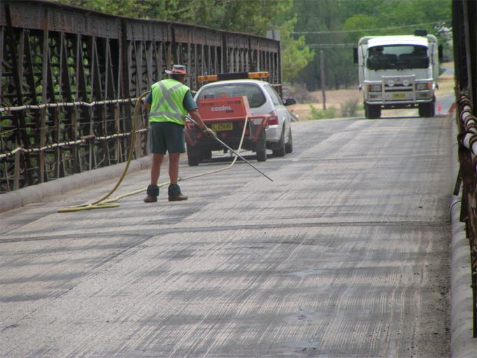
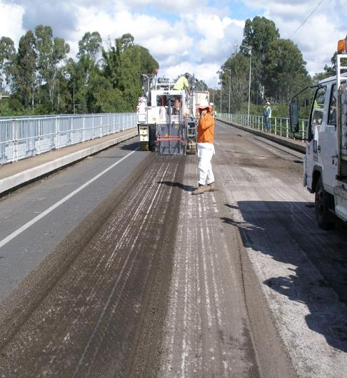
Preparation of surface

Slide 13
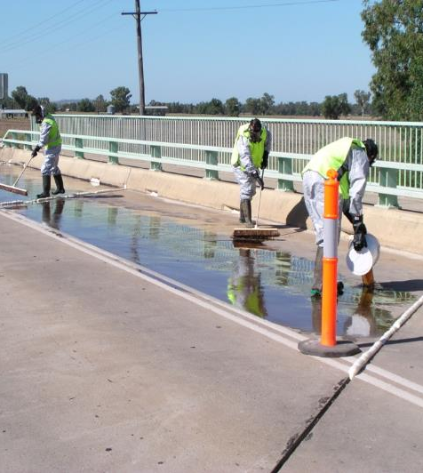
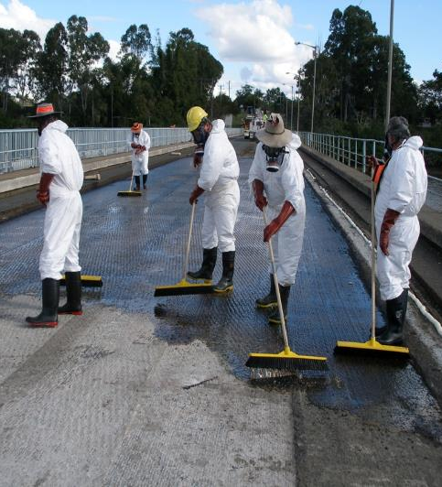
Installation of HMWM

Slide 14
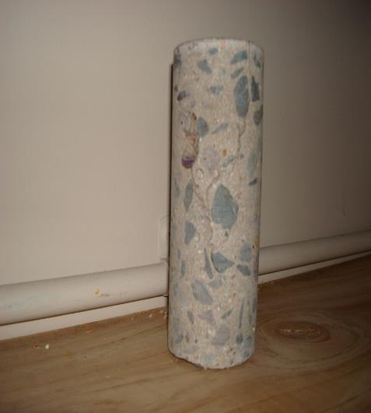
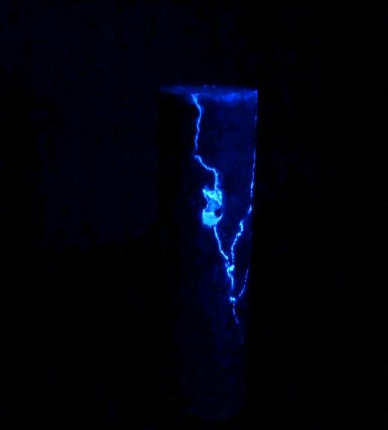
Core treated with HMWM
Under Black Light Chamber

Slide 15
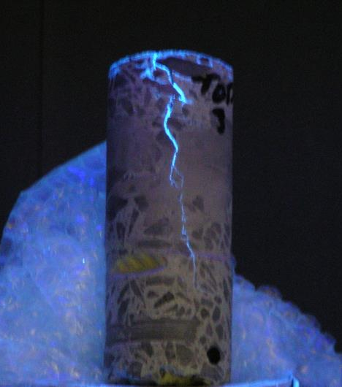
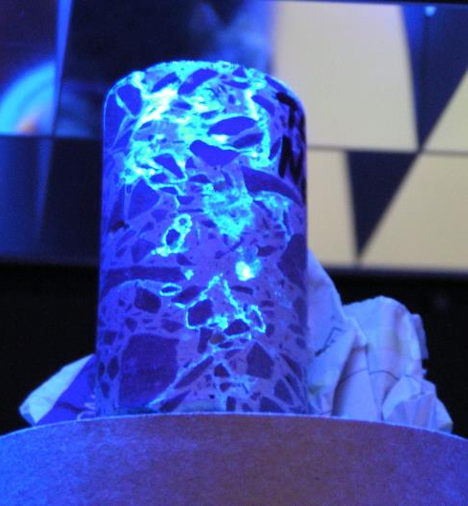
More Photo Under Black Light Chamber

Slide 16
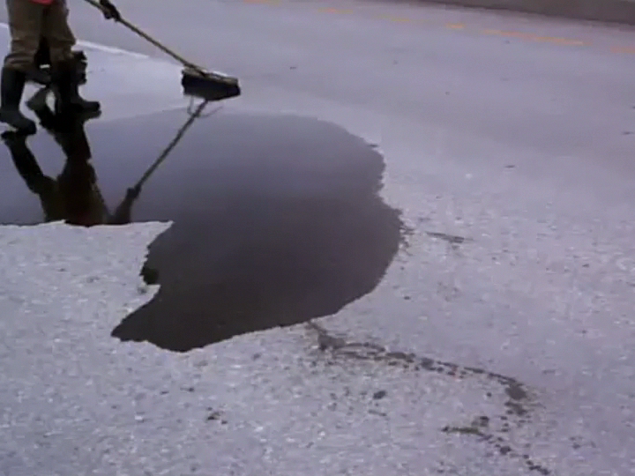


Slide 17
Case study:
Dr.Dave Fowler of The University of Texas, Construction Materials Research Group, Bureau of Engineering Research says, “HMWM has properties that make it easier and safer to use than MMA....” A recent article in Better Roads also cites substantial savings by using HMWM systems for projects in Dallas, Texas and California. Excluding MMA for the reason just cited, HMWM is about the only alternative to epoxy injection especially for small crack or extensive crack repair.
“...Sometimes we specify a thin polymer overlay for a new bridge, instead of a membrane or linseed oil, which don't work very well. It is also often specified to protect older bridges.... Latex helps but it's still not as water tight as the polymer mortars.”
California Department of Transportation (CALTRANS) routinely benefits from the reduced application time to repair a bridge deck and the reduced cost. In a lightweight lift span treated in 1981, the entire repair treatment took seven hours and cost less than $10,000 for material, labor, and traffic control. This was a cost savings of $213,000, or 96% of a $223,000 budget for replacement of the lightweight concrete deck.

Slide 18
Note:
KBP Flex cannot be used to restore structural strength to concrete that has cracked due to improper design, inadequate expansion joints or other structural problems that would be beyond the scope and intended purpose for KBP Flex product

Slide 19
Thank you for your Time Mate!
Please Contract Warajay for further information.
Distributor: WARAJAY INTERNATIONAL (H) PTY LTD
Tel: +61 7 38418833
Fax: +61 7 38414288
Email: info@warajay.com

